Slide 1
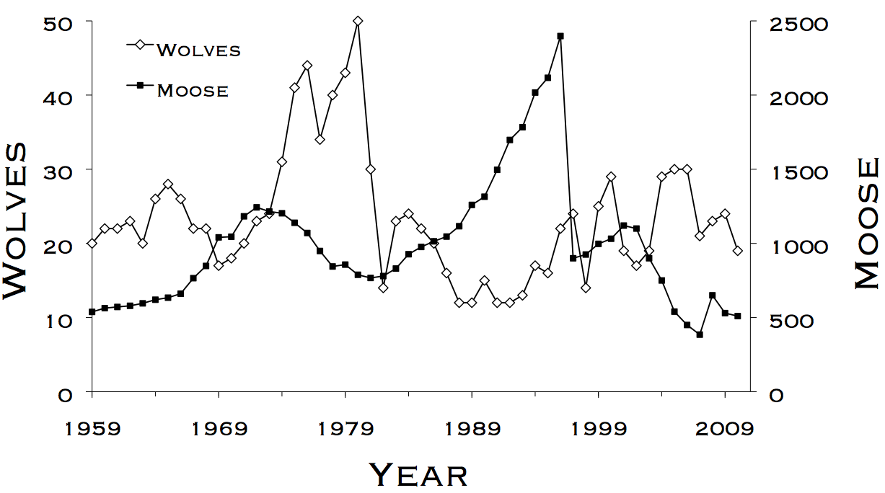
Lab 3 – Analysis of Count Data
WLE 411, Week 6

Slide 2
Readings and deadlines
Lab 2 assignment due at the start of class
Readings for this lab:
Chapter 6- Linear Models
Fall break next week
Notes:
The basics of how linear models are structured

Slide 3


Two ways to write a linear model:
$$y=mx+b$$
$$γ=β_{1}x+β_{0}$$

Slide 4
Response (dependent) variable
$$y=mx+b$$
$$γ=β_{1}x+β_{0}$$
Predictor (independent) variable

Slide 5
Slope
$$y=mx+b$$
$$γ=β_{1}x+β_{0}$$
Y-intercept

Slide 6


What’s the advantage of using the beta structure?
One predictor variable:
$$γ=β_{0}+β_{1}x$$
Two predictor variables:
$$γ=β_{0}+β_{1}x_{1}+β_{2}x_{2}$$

Slide 7


How do we use regression to solve the exponential model?
$$N_{t}=N_{0}+e^{rt}$$
rewritten as
$${ln⁡(N}_{t})={ln⁡(N}_{0})+rt$$
Notes:
Advantages of using a regression framework:
Derive error for our r estimate
Perform tests of statistical significance (eg is r significantly different from 0?)

Slide 8



$$y=mx+b$$
$$γ=β_{1}x+β_{0}$$
$${ln⁡(N}_{t})=rt+{ln⁡(N}_{0})$$

Slide 9



Response (dependent) variable
$$y=mx+b$$
$$γ=β_{1}x+β_{0}$$
$${ln⁡(N}_{t})=rt+{ln⁡(N}_{0})$$
Predictor (independent) variable

Slide 10



Slope
$$y=mx+b$$
$$γ=β_{1}x+β_{0}$$
$${ln⁡(N}_{t})=rt+{ln⁡(N}_{0})$$
Y-intercept

Slide 11
y
How do we estimate the slope of regression lines?
Observed data points
x

Slide 12
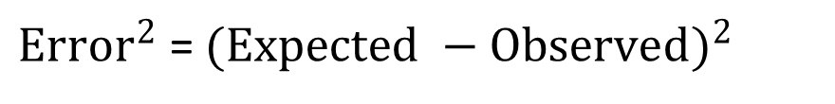
y
Observed y
Expected y
Error = Expected - Observed
${Error}^{2}$ = ${(Expected −Observed)}^{2}$
x

Slide 13
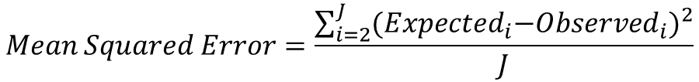
y
Observed y
Expected y
$$Mean Squared Error=\frac{\sum_{i=2}^{J}{{{(Expected}_{i}−{Observed}_{i})}^{2}}}{J}$$
x

Slide 14
y
x

Slide 15
